Slide 1

Department Of
Electronics and Communication
Project Title :
System to check the healthiness of the earthing system and alert staff in case of malfunction.
Team Members: : Deepak Pal (2100540310011)
Md Tahir (2100540310016)
Arun Kumar Singh(2100540310007
Mohd Zaid(2100540310017)

Slide 2

Introduction
Objective: Develop a system to monitor the healthiness of earthing systems and alert staff in case of malfunction.
Importance:
Prevent electrical hazards.
Reduce maintenance costs.
Improve operational safety.

Slide 3
Problem Statement
Manual inspection of earthing systems is:
Time-Consuming
Inefficient
Prone to delayed fault detection
Faults in earthing systems (e.g., high resistance, leakage currents) cause:
Equipment damage.
Safety risks for personnel.

Slide 4
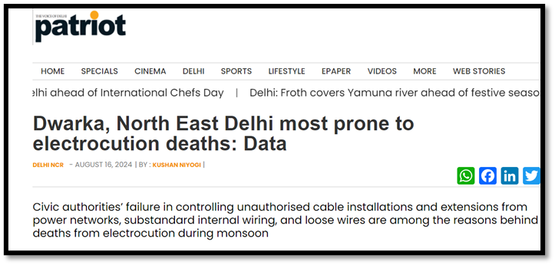
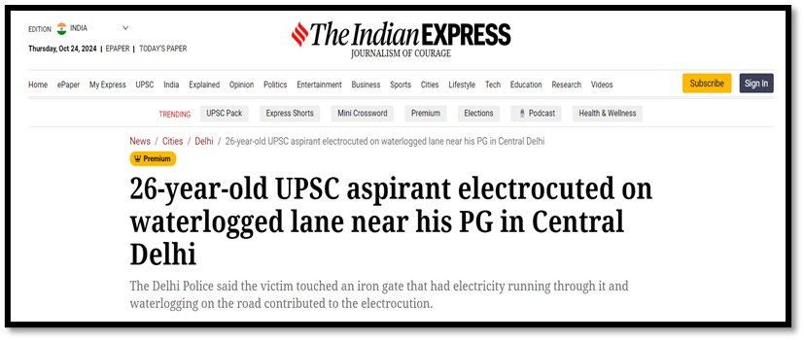
Supporting Article

Slide 5
Literature Review
The earthing system in EHV substations is crucial for personnel and equipment safety, ensuring safe touch and step potentials and the timely operation of protective devices. Comprehensive audits of existing and new substation earthing systems help identify anomalies like grid integrity issues and unsafe potentials, enabling corrective measures. Software simulations post-audit validate safety parameters and ensure compliance with design standards, enhancing overall system reliability and safety.[1]
Grounding ensures the safe dissipation of leakage and fault currents through electrodes like rods, plates, and mesh grids, protecting personnel and equipment in substations. Soil characteristics such as resistivity, mineral content, moisture, and temperature affect earth resistance, necessitating monitoring systems to adapt to environmental changes. This study reviews earthing resistance measurement techniques, grounding system design, and emerging trends in monitoring and controlling substation grounding systems, offering valuable insights for researchers and industry professionals.[2]

Slide 6
Proposed Solution
Real-Time Monitoring System
Automated fault detection using sensors.
Alerts through IoT-enabled notifications.
Scalable, energy-efficient design.

Slide 7
System Overview
Sensors: Measure soil moisture, voltage, current, and continuity.
Microcontroller(ESP32): Processes sensor data.
IoT Module: Sends alerts to the cloud or mobile devices.
Power Source: USB type power source through charger/5v rechargeable battery

Slide 8
Key Features
Continuous monitoring of earthing parameters.
Real-time fault alerts.
Low-power and solar-compatible design.
Cloud-based data visualisation.
Scalable for industrial and public infrastructures.

Slide 9
Benefits
Social: Reduces electrical accidents and fatalities.
Economic: Lowers maintenance and downtime costs.
Environmental energy-efficient system.

Slide 10
Design Methodology
Identified the need for real-time monitoring of earthing health to replace manual, periodic inspections.
Selected ESP32 for its Wi-Fi capability and low power consumption.
Integrated a capacitive soil moisture sensor to assess ground conductivity.
Added voltage (ZMPT101B) and current (ACS712) sensors to detect leakage and fault conditions.
Defined precise threshold values for moisture, voltage, and current to trigger alerts.
Programmed ESP32 using Arduino IDE for continuous sensor monitoring and decision logic.
Connected to Adafruit IO cloud via MQTT for remote data logging and push notifications.
Implemented buzzer and LED for on-site audible and visual fault alerts.
Conducted field trials in wet, dry, and moderate soil conditions for real-world validation.
Achieved 100% fault detection accuracy with zero false alarms and <3s response time

Slide 11
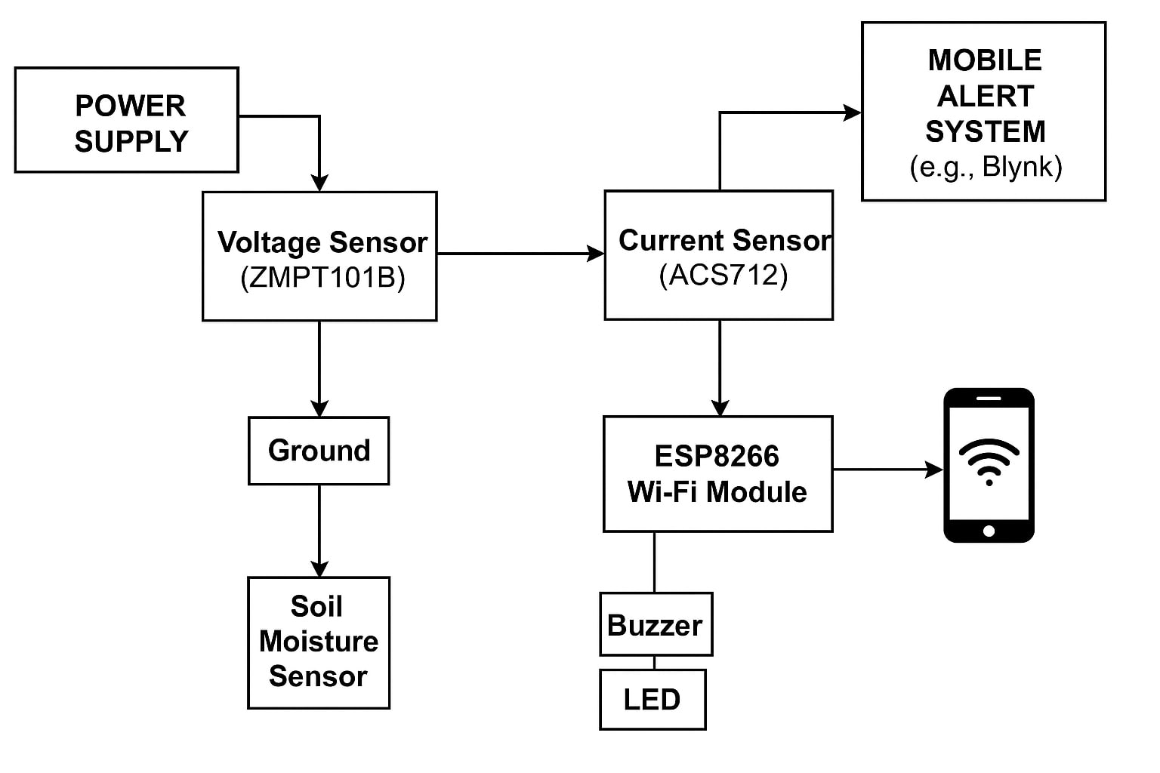
Flow Diagram

Slide 12
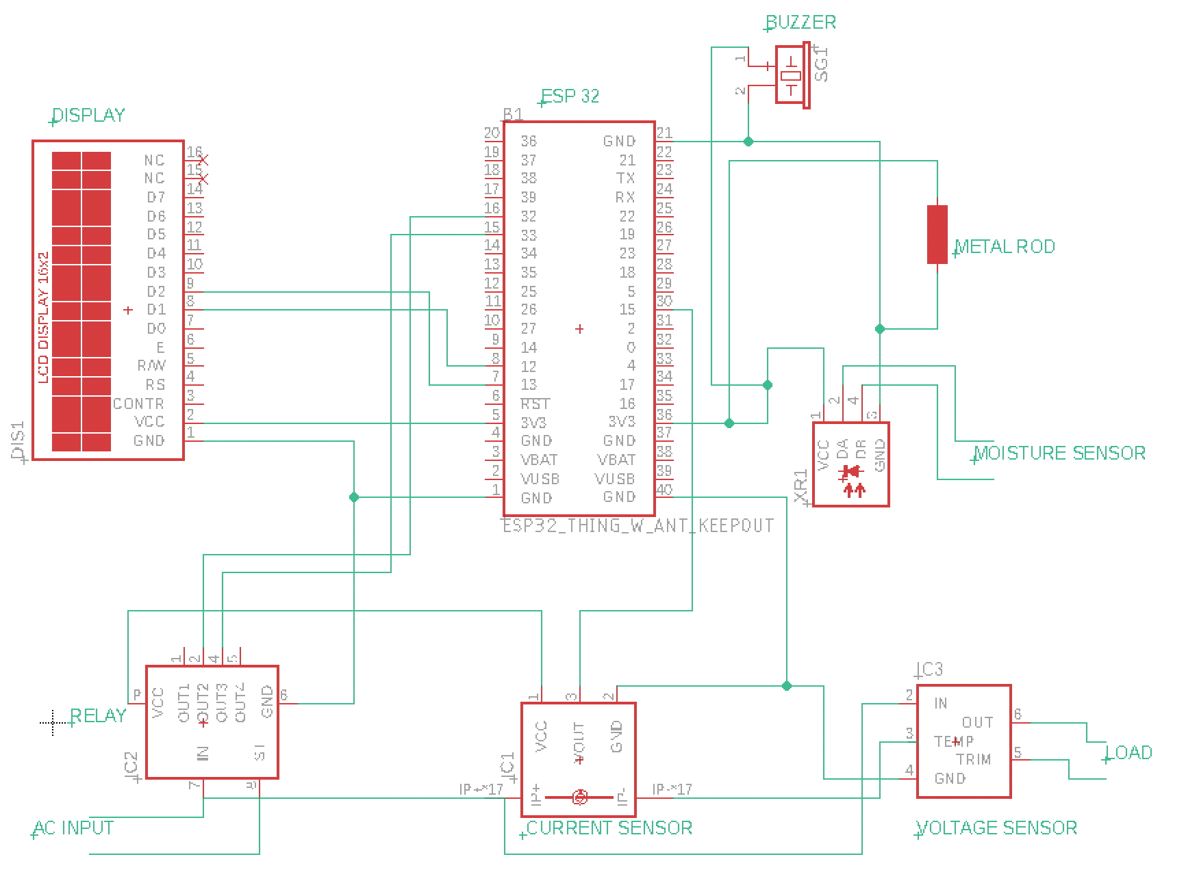
Circuit Diagram

Slide 13

Circuit Working Description
Circuit Working Description​
Sensors detect critical parameters.​
Microcontroller processes and analyses sensor data.​
Fault conditions trigger alerts via IoT modules.​
Power supply from solar panels ensures 24/7 operation.

Slide 14
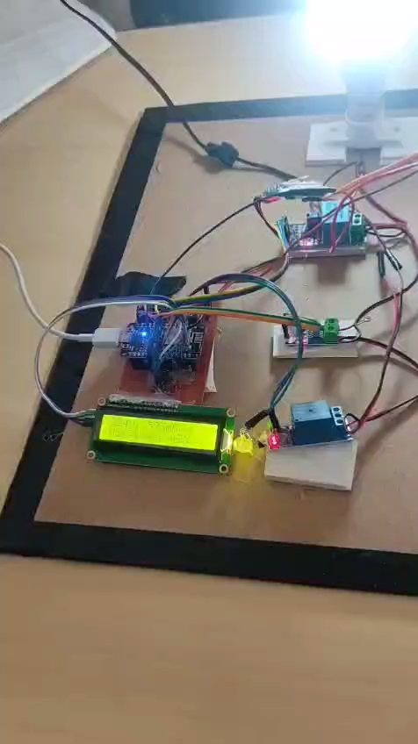
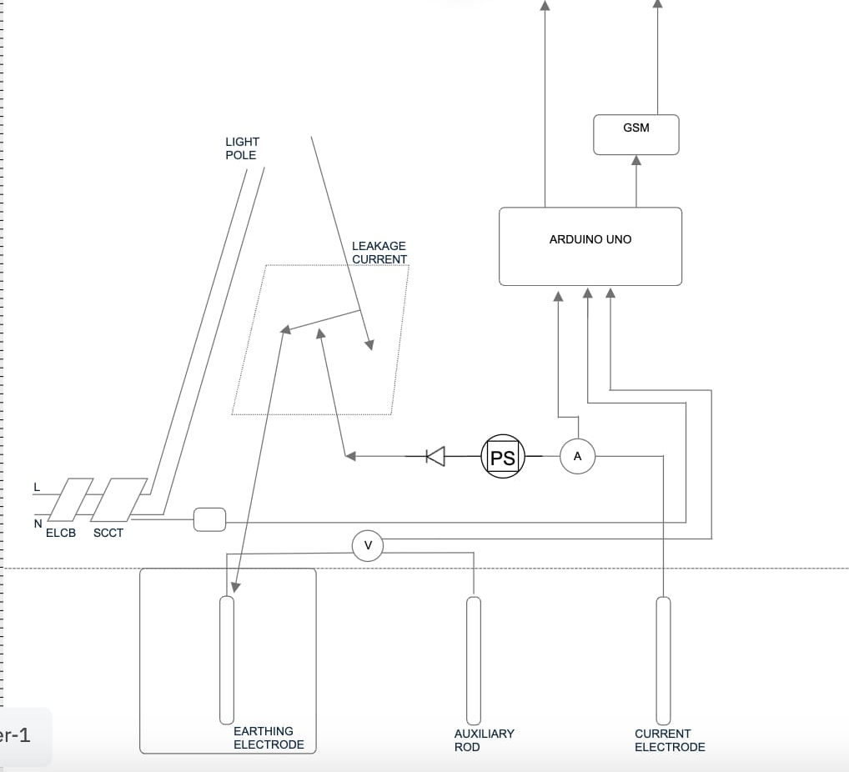
Course of Operation

Slide 15
Hardware Component
Sensors:
Moisture Sensor
Current Sensor
Voltage Sensor
Microcontroller: ESP32
Communication Interface: Adafruit IO via Wi-Fi
Power: DC power supply/ 5v rechargeable batteries

Slide 16
Cost Estimation
Component | Qty | Unit Price (₹) | Total (₹)
ESP32-WROOM | 1 | 600 | 600
Soil Moisture Sensor | 1 | 900 | 900
ACS712 Current Sensor | 1 | 350 | 350
ZMPT101B Voltage Sensor | 1 | 300 | 300
Charger+ cable + Bulb | 1 | 350 | 300
Miscellaneous |  | 2000 | 2000
Subtotal |  |  | 4,450

Slide 17
Challenges and Risks
Sensor calibration and accuracy.
Network connectivity in remote areas.
Initial deployment costs.
Ensuring scalability for large infrastructures.

Slide 18
Strategies to Overcome Challenges
Use robust sensors with self-calibration capabilities.
Employ hybrid communication (LoRaWAN + GSM).
Optimize design for mass production to reduce costs.
Conduct pilot testing to refine scalability.

Slide 19
Potential Impact
Enhanced safety for personnel and public infrastructure.
Reduced downtime and maintenance expenses.
Contribution to smart city initiatives.

Slide 20
Conclusion
The proposed system ensures:
Reliable monitoring of earthing systems.
Prevention of electrical hazards.
Cost-effective and scalable implementation.
Ready for deployment in industrial, residential, and public infrastructures.

Slide 21
Reference
Bibliographical Review of Monitoring and Controlling Technique for Earthing System Rahul Agarwal1*,Swati Gade2, M. Ahfaz Khan3 and Nagendra Singh4
HEALTH ASSESSMENT OF AN EHV EARTHING SYSTEM. Anwesh Kumar Maddikunta MIEEE,
"The Importance of Earthing Systems in Electrical Safety" - IEEE Xplore
"IoT-Based Monitoring Systems for Electrical Applications" - Springer
"Solar-Powered IoT Solutions for Smart Cities" - ResearchGate
News Article: Electrical Hazards Due to Poor Earthing

Slide 22
Q&A
Thank You for Your Attention!
Questions and feedback are welcome.

